Slide 1

COMPUTER ORGANIZATION AND ARCHITECTURE
Introduction

Slide 2
BASIC STRUCTURE OF COMPUTERS

Slide 3
Definition of Computer
Types of computer
Functional Units
Performance

Slide 4
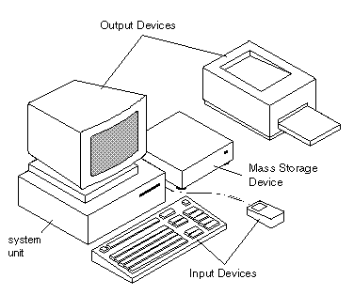
INTRODUCTION TO COMPUTERS
A computer is a fast electronic device that accepts digitized input information, processes it in accordance with predetermined list of instructions that are internally stored, and produce the resulting output.

Slide 5
INTRODUCTION….
They come in different sizes and different power.
The types of computers based on the criteria namely size, speed and cost are :
Personal (Desktop)
Portable Notebook
Mainframe
Supercomputers

Slide 6
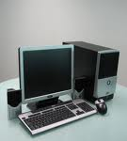
PERSONAL COMPUTER

Slide 7
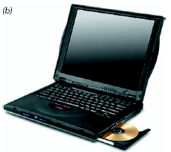
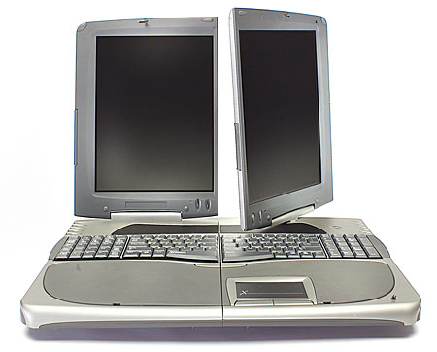
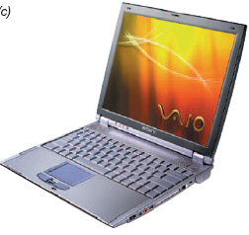
PORTABLE NOTEBOOK COMPUTER

Slide 8
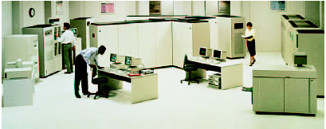
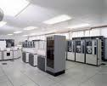
MAINFRAME COMPUTERS
Used for business data processing

Slide 9

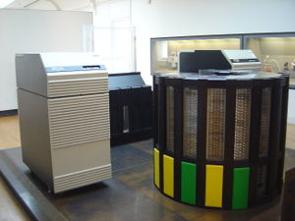
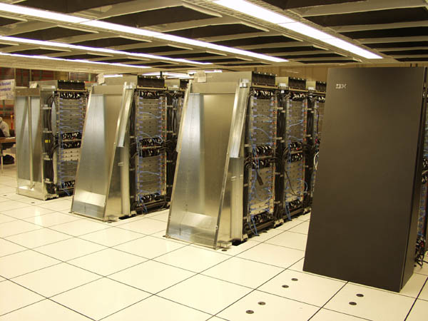
SUPERCOMPUTERS
Used for large scale numerical calculations

Slide 10
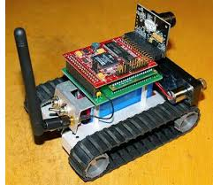
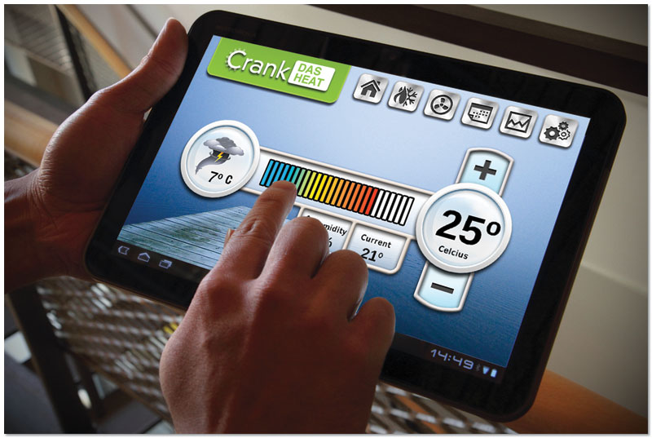


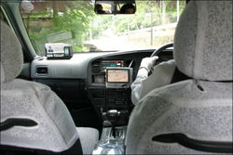
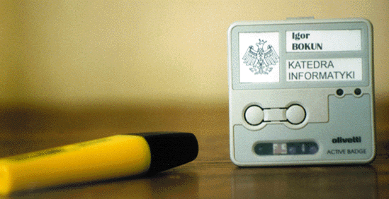
EXAMPLES OF EMBEDDED SYSTEMS

Slide 11
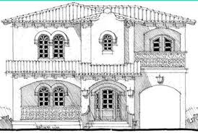
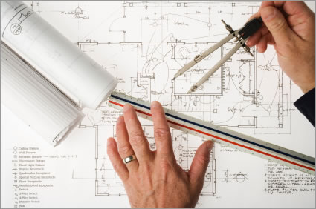
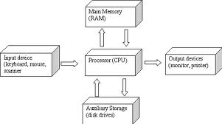
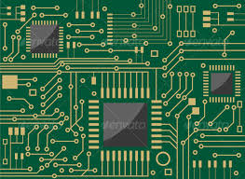
COMPUTER ARCHITECTURE VS COMPUTER ORGANIZATION
Building Architecture :: Structural design.
Computer Architecture:: Circuit design (Organization)

Slide 12
CONTINUATION…
Computer Architecture : The attributes that are visible to the programmer . Ex: physical address memory, CPU , Adders etc.
Computer Organization: How these features are implemented. ie. How the transistors and registers are put together to have the plan.

Slide 13
FUNCTIONAL UNITS

Slide 14
FUNCTIONAL UNITS
Arithmetic
Input
and
logic
Memory
Output
Control
I/O
Processor
Basic functional units of a computer.

Slide 15
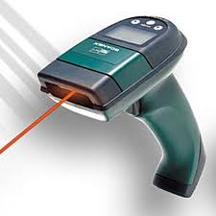
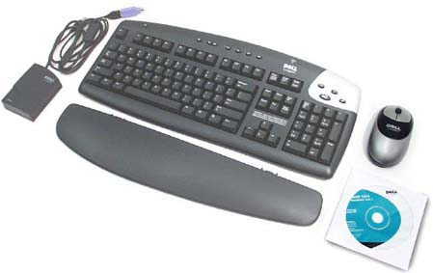
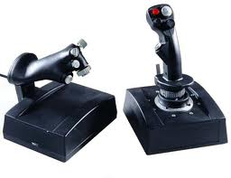
INPUT UNIT
Computers accept coded information through input units which read the data.
In a Keyboard when a key is pressed the corresponding digit or letter is automatically translated into its corresponding binary code and transmitted over a cable to either the memory or the processor.

Slide 16
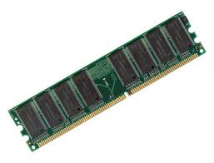
MEMORY UNIT
Store programs and data
Two classes of storage
Primary storage
  Fast
  Programs must be stored in memory while they are being executed
  Large number of semiconductor storage cells
  Processed in words
  Address
  RAM and memory access time
  Memory hierarchy – cache, main memory
Secondary storage – larger and cheaper

Slide 17
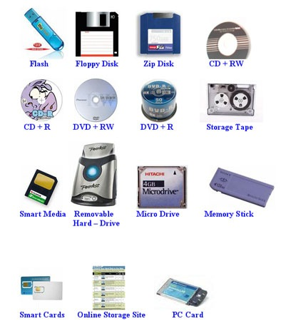
CONTINUATION…
Secondary storage used when large amount of data and many programs have to be stored.

Slide 18
ARITHMETIC AND LOGIC UNIT (ALU)
Most computer operations are executed in ALU of the processor.
Load the operands into memory – bring them to the processor – perform operation in ALU – store the result back to memory or retain in the processor.
Registers

Slide 19
CONTROL UNIT
All computer operations are controlled by the control unit.
The timing signals that govern the I/O transfers are also generated by the control unit.
Control unit is usually distributed throughout the machine instead of standing alone.
Operations of a computer:
Accept information in the form of programs and data through an input unit and store it in the memory
Fetch the information stored in the memory, under program control, into an ALU, where the information is processed
Output the processed information through an output unit
Control all activities inside the machine through a control unit

Slide 20
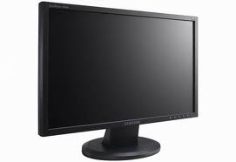
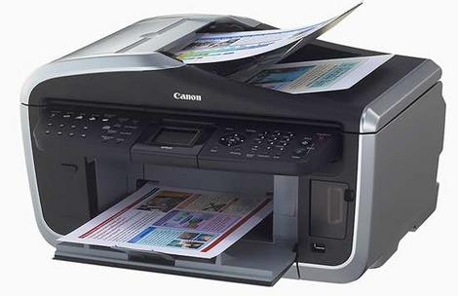
OUTPUT UNIT
It sends the processed result to the outside world.

Slide 21
INFORMATION HANDLED BY A COMPUTER
Instructions/machine instructions
Govern the transfer of information within a computer as well as between the computer and its I/O devices
Specify the arithmetic and logic operations to be performed
Program
Data
Used as operands by the instructions
Source program
Encoded in binary code – 0 and 1

Slide 22
PERFORMANCE

Slide 23
PERFORMANCE
The most important measure of a computer is how quickly it can execute programs.
Three factors affect performance:
  Hardware design
    Cache
    Processor Clock
  Instruction set
    CISC
    RISC
  Compiler

Slide 24
HARDWARE DESIGN :CACHE MEMORY
  The processor and a relatively small cache memory can be fabricated on a single integrated circuit chip.
  Speed
  Cost
  Memory management
Main
Cache
memory
memory
Processor
Bus
The processor cache.

Slide 25
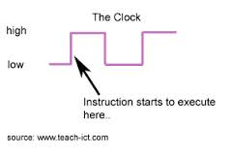
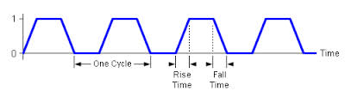
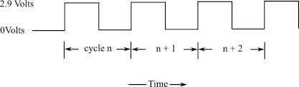
PROCESSOR CLOCK
Clock, clock cycle, and clock rate
Processor Circuits are controlled by a timing signal called clock
R=1/P, where P is the length of one clock cycle. Measured as Hertz – cycles per second
The execution of each instruction is divided into several steps, each of which completes in one clock cycle.

Slide 26
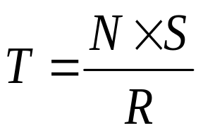
BASIC PERFORMANCE EQUATION
T – processor time required to execute a program that has been prepared in high-level language
N – number of actual machine language instructions needed to complete the execution (note: loop)
S – average number of basic steps needed to execute one machine instruction. Each step completes in one clock cycle
R – clock rate
Note: these are not independent to each other

Slide 27


